Slide 1
Suicide
Introduction and Book One: Extra-Social Factors

Slide 2
New Project
Okay, rather than a test, let’s gather data on suicide from the US in recent times and see how many of the questions Durkheim asks we can answer using modern data.
Questions to try to answer:
Get data on suicide rates in the US for as far back as we can
http://webappa.cdc.gov/sasweb/ncipc/mortrate.html
Ideally get data for states as far back as we can
Also get data for the following as far back as possible: race, sex, motivations, method, occupations, and age
Try to get data on months of suicides; if possible, get seasonal temperature data to match up
Get data on suicide rates in other countries over time to compare with the US
For state comparisons, get data on: religious affiliations by state, alcoholism by state, insanity rates by state, average temperatures by state, marriage rates by state (including widowed, single, etc.)
I’d also like to see if there is any evidence supporting inheritability of suicide; do a search for twins studies and suicide
I’d also like to see suicide rates among active duty soldiers
You need to turn in spreadsheets, Powerpoints, and any statistical analysis you do

Slide 3
Introduction
Given what we just discussed about classical theory, why read Durkheim?
Suicide is a great example of empirical investigation and theory building
He may not be completely correct in everything he proposes, but he lays out how to develop a theory and test it
Durkheim was interested in “progress”, but it appears to be a little different:
P. 35 “The progress of a science is proven by the progress toward solution of the problems it treats.”

Slide 4
Psychology vs. Sociology
Intriguing question to start this discussion:
But isn’t suicide a psychological problem?
If it were purely psychological, would rates be constant from year to year yet vary from society to society?
It’s both psychological and sociological

Slide 5
Data
Draws on data from lots of European countries
Includes data on 26,000 suicides
Doesn’t do a great job of describing his data, but it is pretty good for the time period
Lots of other early scholars and sociologists did not have statistics
Would we present our data the same way today?
Can you imagine managing that much data without a computer?

Slide 6
Definitions
Durkheim on the importance of definitions:
P. 41 “He himself must establish the groups he wishes to study in order to give them the homogeneity and the specific meaning necessary for them to be susceptible of scientific treatment.”
First definition (p. 42):
“the term suicide is applied to any death which is the direct or indirect result of a positive or negative act accomplished by the victim himself.”
So, what’s the difference between a suicide, a martyr, and someone who dies trying to save someone else?
Second definition (p. 44):
“the term suicide is applied to all cases of death resulting directly or indirectly from a positive or negative act of the victim himself, which he knows will produce this result”
How are these two different? Is the difference important? Who is ruled out?

Slide 7
Just for fun…
Just for fun, does this mean Jesus committed suicide?
Definition of suicide from Catholic Encyclopedia: “Suicide is the act of one who causes his own death, either by positively destroying his own life, as by inflicting on himself a mortal wound or injury, or by omitting to do what is necessary to escape death, as by refusing to leave a burning house.”
"Everyone is responsible for his life before God who has given it to him. It is God who remains the sovereign Master of life. We are obliged to accept life gratefully and preserve it for his honor and the salvation of our souls. We are stewards, not owners, of the life God has entrusted to us. It is not ours to dispose of."
http://www.newadvent.org/cathen/14326b.htm

Slide 8
Questions
So, Durkheim starts out asking a bunch of questions:
Do suicide rates vary by country?
Do suicide rates vary by year within a country?
How do suicide rates compare with general mortality rates?

Slide 9
Table I – Stability of Suicide in the Principal European Countries (absolute figures)
Years | France | Prussia | England | Saxony | Bavaria | Denmark
1841 | 2,814 | 1,630 |  | 290 |  | 337
1842 | 2,866 | 1,598 |  | 318 |  | 317
1843 | 3,020 | 1,720 |  | 420 |  | 301
1844 | 2,973 | 1,575 |  | 335 | 244 | 285
1845 | 3,082 | 1,700 |  | 338 | 250 | 290
1846 | 3,102 | 1,707 |  | 373 | 220 | 376
1847 | (3,647) | (1,852) |  | 377 | 217 | 345
1848 | (3,301) | (1,649) |  | 398 | 215 | (305)
1849 | 3,583 | (1,527) |  | (328) | (189) | 337
1850 | 3,596 | 1,736 |  | 390 | 250 | 340
1851 | 3,598 | 1,809 |  | 402 | 260 | 401
1852 | 3,676 | 2,073 |  | 530 | 226 | 426
1853 | 3,415 | 1,942 |  | 431 | 263 | 419

Slide 10
Table I – Stability of Suicide in the Principal European Countries (absolute figures)
Years | France | Prussia | England | Saxony | Bavaria | Denmark
1854 | 3,700 | 2,198 |  | 547 | 318 | 426
1855 | 3,810 | 2,351 |  | 568 | 307 | 419
1856 | 4,189 | 2,377 |  | 550 | 318 | 363
1857 | 3,967 | 2,038 | 1,349 | 485 | 286 | 399
1858 | 3,903 | 2,126 | 1,275 | 491 | 329 | 426
1859 | 3,899 | 2,146 | 1,248 | 507 | 387 | 427
1860 | 4,050 | 2,105 | 1,365 | 548 | 339 | 457
1861 | 4,454 | 2,185 | 1,347 | (643) |  | 451
1862 | 4,770 | 2,112 | 1,317 | 557 |  | 468
1863 | 4,613 | 2,374 | 1,315 | 643
1864 | 4,521 | 2,203 | 1,340 | (545) |  | 411
1865 | 4,946 | 2,361 | 1,392 | 619 |  | 451
1866 | 5,119 | 2,485 | 1,329 | 704 | 410 | 443

Slide 11
Table I – Stability of Suicide in the Principal European Countries (absolute figures)
Years | France | Prussia | England | Saxony | Bavaria | Denmark
1867 | 5,011 | 3,625 | 1,316 | 752 | 471 | 469
1868 | (5,547) | 3,658 | 1,508 | 800 | 453 | 498
1869 | 5,114 | 3,544 | 1,588 | 710 | 425 | 462
1870 |  | 3,270 | 1,554 |  |  | 486
1871 |  | 3,135 | 1,495
1872 |  | 3,467 | 1,514
If suicide rates differ by country, but are fairly constant within countries, what does that mean?
Could variable rates in different societies reflect different genetic predispositions?

Slide 12
Rates
Each society has a definite aptitude for suicide
Aptitude is measured by taking the proportion between the total number of voluntary deaths and the population of every age and sex:
The rate of mortality through suicide, characteristic of the society under consideration

Slide 13
Table II – Comparative Variations of the Rate of Mortality by Suicide and the Rate of General Mortality - France
Period 1841-46 | Suicides per 100,000 Inhabitants | Deaths per 1,000 Inhabitants | Period 1849-55 | Suicides per 100,000 Inhabitants | Deaths per 1,000 Inhabitants
1841 | 8.2 | 23.2 | 1849 | 10.0 | 27.3
1842 | 8.3 | 24.0 | 1850 | 10.1 | 21.4
1843 | 8.7 | 23.1 | 1851 | 10.0 | 22.3
1844 | 3.5 | 22.1 | 1852 | 10.5 | 22.5
1845 | 8.8 | 21.2 | 1853 | 9.4 | 22.0
1846 | 8.7 | 23.2 | 1854 | 10.2 | 27.4
 |  |  | 1855 | 10.5 | 25.9
Ave. | 8.5 | 22.8 | Ave. | 10.1 | 24.1

Slide 14
Table II – Comparative Variations of the Rate of Mortality by Suicide and the Rate of General Mortality
Period 1856-60 | Suicides per 100,000 Inhabitants | Deaths per 1,000 Inhabitants
1856 | 11.6 | 23.1
1857 | 10.9 | 23.7
1858 | 10.7 | 24.1
1859 | 11.1 | 26.8
1860 | 11.9 | 21.4
Averages | 11.2 | 23.8
What’s the pattern you see?
Is suicide more stable than general mortality?

Slide 15
Table III – Rate of Suicides per Million Inhabitants in the Different European Countries
 | 1866-70 | 1871-75 | 1874-78 | Position period 1 | Position period 2 | Position period 3
Italy | 30 | 35 | 38 | 1 | 1 | 1
Belgium | 66 | 69 | 78 | 2 | 3 | 4
Englund | 67 | 66 | 69 | 3 | 2 | 2
Norway | 76 | 73 | 71 | 4 | 4 | 3
Austria | 78 | 94 | 130 | 5 | 7 | 7
Sweden | 85 | 81 | 91 | 6 | 5 | 5
Bavaria | 90 | 91 | 100 | 7 | 6 | 6
France | 135 | 150 | 160 | 8 | 9 | 9
Prussia | 142 | 134 | 152 | 9 | 8 | 8
Denmark | 277 | 258 | 255 | 10 | 10 | 10
Saxony | 293 | 267 | 334 | 11 | 11 | 11
What does this table illustrate?
Are general mortality rates as different between countries as are suicide rates?

Slide 16
Suicide and Psychopathic States
Having given some basic information on suicide rates, Durkheim now turns to explanations
Purpose of the first chapter, rule out:
Psychological causes, exclusively
Physical environment causes, exclusively
Psychology:
P. 59 “If suicide can be shown to be a mental disease with its own characteristics and distinct evolution, the question is settled: every suicide is a madman.”
What does he mean here?
How can we know if something is psychological or sociological?
How can we know if suicide is psychological or sociological?

Slide 17
Psychology
He suggests suicide could be a monomania
Monomania = fixation with one thing; in the case of suicide, that would be death or dying
Asserts that suicides would be sane except in this one regard (p. 59)
Is this a logically valid assertion?
He rules out monomania as the cause of suicide because he does not believe people are truly monomaniacs in the sense that they only have one problem they fixate on
Is this a logically valid suggestion?
Keep in mind two things:
I’m not an expert in psychology
And neither was Durkheim… (though maybe for his day)

Slide 18
Psychology
Maybe suicides are insane? Maybe there are various types of insane suicides?
Maniacal suicide – due to hallucinations or delirious conceptions
Melancholy suicide – general state of extreme depression and exaggerated sadness, causing the patient no longer to realize sanely the bonds which connect him with people and things about him
Obsessive suicide – fixated on the idea of death, which has, without clear reason, taken complete possession of the patient’s mind
Impulsive or automatic suicide – unmotivated; has no cause in reality; results from an immediate, irresistible impulse
His conclusion:
P. 66 "In short, all suicides of the insane are either devoid of any motive or determined by purely imaginary motives. Now, many voluntary deaths fall into neither category; the majority have motives, and motives not unfounded in reality. Not every suicide can therefore be considered insane, without doing violence to language."
Also argues that insane melancholy suicides don’t have a reason for their depression; sane, melancholy suicides do

Slide 19
Psychology
What about neurasthenia?
Neurasthenia is a psycho-pathological term first used by George Miller Beard in 1869 to denote a condition with symptoms of fatigue, anxiety, headache, impotence, neuralgia and depressed mood. It was explained as being a result of exhaustion of the central nervous system's energy reserves, which Beard attributed to modern civilization. It is no longer included as a diagnosis in the American Psychiatric Association's Diagnostic and Statistical Manual of Mental Disorders although there is a category of Undifferentiated Somatoform Disorders.
Women were more likely to be diagnosed with neurasthenia than men.
Durkheim argues that, since women were more likely to be neurasthenics than men, this can’t explain suicide
But what about insanity in general?

Slide 20
Number of Men and Women to 100 Insane
 | Year | Men | Women
Silesia | 1858 | 49 | 51
Saxony | 1861 | 48 | 52
Wurtemberg | 1853 | 45 | 55
Denmark | 1847 | 45 | 55
Norway | 1855 | 45 | 56
New York | 1855 | 44 | 56
Massachusetts | 1854 | 46 | 54
Maryland | 1850 | 46 | 54
France | 1890 | 47 | 53
France | 1891 | 48 | 52
So, women are more likely to be insane than men?

Slide 21
Table IV – Share of Each Sex in the Total Number of Suicides
 | Absolute # of Suicides |  | # of to 100 Suicides
 | Men | Women | Men | Women
Austria (1873-77) | 11,429 | 2,478 | 82.1 | 17.9
Prussia (1831-40) | 11,435 | 2,534 | 81.9 | 18.1
Prussia 11871-76) | 16,425 | 3,724 | 81.5 | 18.5
Italy (1872-77) | 4,770 | 1,195 | 80.0 | 20.0
Saxony (1851-60) | 4,004 | 1,055 | 79.1 | 20.9
Saxony (1871-76) | 3,625 | 870 | 80.7 | 19.3
France (1836-40) | 9,561 | 3,307 | 74.3 | 25.7
France (1851-55) | 13,596 | 4,601 | 74.8 | 25.2
France (1871-76) | 25,341 | 6,839 | 79.7 | 21.3
Denmark (1845-56) | 3,324 | 1,106 | 75.0 | 25.0
Denmark (1870-76) | 2,485 | 748 | 76.9 | 23.1
England (1863-67) | 4,905 | 1,791 | 73.3 | 26.7
If suicide results from insanity, how do you explain that men commit suicide far more often than women despite the fact that women make up a slight majority in mental institutions?

Slide 22
Table V – Tendency to Insanity Among the Different Religious Faiths
Number of insane per 1,000 inhabitants of each faith
 | Protestants | Catholics | Jews
Silesia (1858) | 0.74 | 0.79 | 1.55
Mecklenburg (1862) | 1.36 | 2.00 | 5.33
Duchy of Baden (1863) | 1.34 | 1.41 | 2.24
Duchy of Baden (1873) | 0.95 | 1.19 | 1.44
Bavaria (1871) | 0.92 | 0.96 | 2.86
Prussia (1871) | 0.80 | 0.87 | 1.42
Wurtemberg (1832) | 0.65 | 0.68 | 1.77
Wurtemberg (18531 | 1.06 | 1.06 | 1.49
Wurtemberg (1875) | 2.18 | 1.86 | 3.96
Grand Duchy of Hess (1864) | 0.63 | 0.59 | 1.42
Oldenburg (1871) | 2.12 | 1.76 | 3.37
Canton of Bern (1871) | 2.64 | 1.82 | ...
Jews are the least likely to commit suicide. So, if suicide is due to insanity, how do you explain their lower proclivity toward suicide despite their higher insanity rates?

Slide 23
Table VI – Relations of Suicide and Insanity in Different European Countries
 | No. Insane per 100,000 Inhabitants |  | No. Suicides per 1,000,000 Inhabitants |  | Insanity | Suicide
Norway | 180 | 1855 | 107 | (1851-55) | 1 | 4
Scotland | 164 | 1855 | 34 | (1856-60) | 2 | 8
Denmark | 125 | 1847 | 258 | (1846-50) | 3 | 1
Hannover | 103 | 1856 | 13 | (1856-60) | 4 | 9
France | 99 | 1856 | 100 | (1851-55) | 5 | 5
Belgium | 92 | 1858 | 50 | (1855-60) | 6 | 7
Wurtemburg | 92 | 1853 | 108 | (1846-56) | 7 | 3
Saxony | 67 | 1861 | 245 | (1856-60) | 8 | 2
Bavaria | 57 | 1858 | 73 | (1846-56) | 9 | 6
Is there a significant correlation here?
(NOTE: r = -.13)

Slide 24
Morselli’s definition of idiots and insane
 | Mentally Alienated per 100,000 Inhabitants | Suicides per 1,000,000 Inhabitants
1st Group (3 countries) | from 340 to 280 | 157
2nd Group (3 countries) | from 261 to 245 | 195
3rd Group (3 countries) | from 135 to 164 | 65
4th Group (3 countries) | from 150 to 116 | 61
5th Group (3 countries) | from 110 to 100 | 68
What did “idiot” mean back then?
Was it pejorative?

Slide 25
Koch’s definition of idiot and insane
 | Insane and Idiots per 100,000 Inhabitants | Average of Suicides per 1,000,000 Inhabitants
1st Group (3 countries) | from 422 to 305 | 76
2nd Group (3 countries) | from 305 to 291 | 123
3rd Group (3 countries) | from 268 to 244 | 130
4th Group (3 countries) | from 223 to 218 | 227
5th Group (4 countries) | from 216 to 146 | 77
Durkheim considers this better data and finds, of course, no correlation.

Slide 26
Alcoholism
Okay, so he ruled out insanity
What about alcoholism?
Does consuming more alcohol increase the odds of committing suicide?
Notes that suicide is most prevalent among the wealthy, but alcoholism is not
Then contrasts maps for suicide and alcoholism

Slide 27
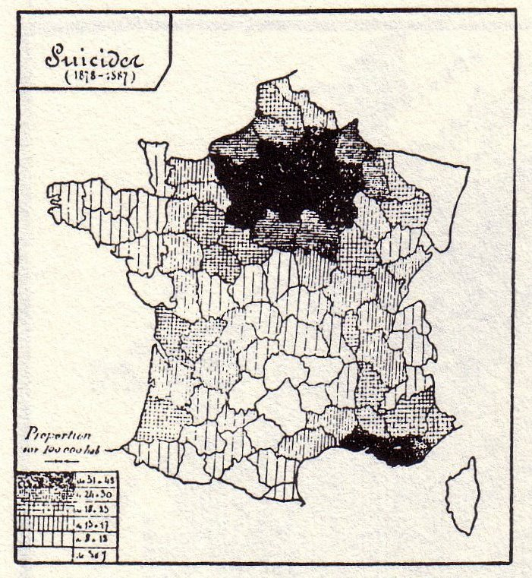
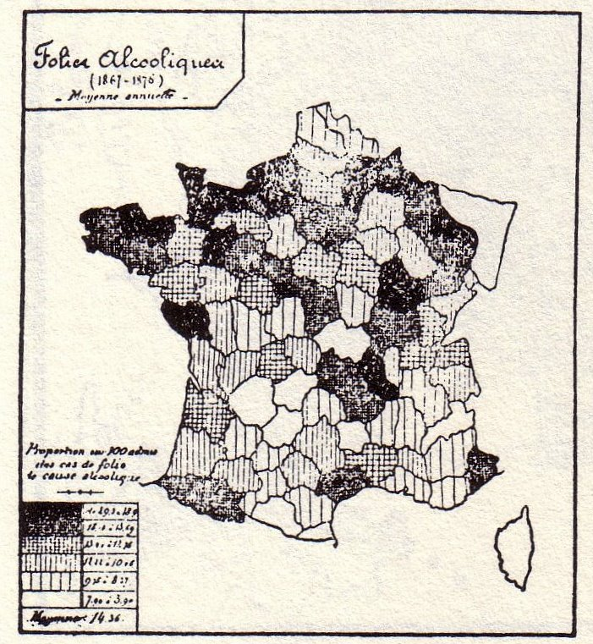
Regional Patterns of Suicide and Alcohol
Suicide Rates
Alcoholics

Slide 28
Regional Patterns of Suicide and Alcohol
Suicide Rates
Offense of drunkenness

Slide 29
Regional Patterns of Suicide and Alcohol
Consumption of alcohol
Suicide Rates

Slide 30
Alcohol and Suicide
Interestingly, if you rank the suicides per 100,000 column then correlate the rank with the alcoholic insane admissions, you get a correlation of .75; was Durkheim wrong on this point?
 | Suicides per 100,000 Inhabitants (1872-76) | Alcoholic Insane per 100 Admissions (1867-69 and 1874-76)
1st Group ( 5 departments) | Below 50 | 11.45
2nd Group (18 departments) | From 51 to 75 | 12.07
3rd Group (15 departments) | From 76 to 100 | 11.92
4th Group (20 departments) | From 101 to 150 | 13.42
5th Group (10 departments) | From 151 to 200 | 14.57
6th Group ( 9 departments) | From 201 to 250 | 13.26
7th Group ( 4 departments) | From 251 to 300 | 16.32
8th Group ( 5 departments) | Above | 13.47

Slide 31
Alcoholism and Suicide in Germany
 | Consumption of Alcohol (1884-46) Liters per Capita | Ave. of Suicides per 1,000,000 Inhabitants | Country
1st Group | 13 to 10.8 | 206.1 | Posnania, Silesia, Brandenburg, Pomerania
2nd Group | 9.2 to 7.2 | 208.40 | East and West Prussia, Hanover, Province of Saxony, Thuringia, Westphalia
3rd Group | 6.4 to 4.5 | 234.10 | Mecklenburg, Kingdom Saxony, Schleswig-Holstein, Alsace, Grand Duchy Hess
4th Group | 4 and less | 148 | Rhine provinces, Baden, Bavaria Wurtemburg
Pretty clearly no correlation here

Slide 32
Suicide and Normal Psychological States – Race, Heredity
So, he concludes psychology and alcoholism don’t contribute to suicide
What about race?
I love his understanding of race – reflects cutting edge science circa 1897:
P. 83 “According to this school (polygenists), instead of being derived as a whole from one and the same couple, in the manner of biblical tradition, humanity has appeared either simultaneously or successively at different points on the globe. As these primitive stocks were formed independently of one another and in different environments, they differed from the beginning; hence, each of them would be a race. Therefore, the principal races would not have been formed by a progressive fixation of acquired differences, but from the beginning and all at once.”

Slide 33
Defining Race
He spends quite a bit of time defining race (again, note the importance of definitions):
Prichard: “By the term race is understood any collection of individuals with a greater or less number of common characteristics transmissible by heredity, regardless of the origin of these characteristics.”
Broca: “The varieties of human kind have received the name of races, which suggests the idea of a more or less direct filiation between the individuals of the same variety, but this neither affirmatively nor negatively determines the question of kinship between individuals of different varieties.”
Are these good definitions?

Slide 34
Race
Concludes there are four great races of Europeans:
Germanic type – Germans, Scandinavians, Anglo-Saxons, Flemish
Celto-Roman type – Belgians, French, Italians, Spaniards
Slav Type
Ural-Altaic type
When I say “four races of Europeans,” are these what you think of?
Are these closer to ethnic groups?
Maybe – still very different
Illustrative of the changing understandings of sociology over time
Finds small differences between races, but greater differences between countries of the same race

Slide 35
Table VII – Comparison of Austrian Provinces with Respect to Suicide and Race
 |  | No. of Germans per 100 Inhabitants | Suicide-rate per Million
Provinces purely German | Lower Austria | 95.90 | 254 | Average 106
 | Upper Austria | 100 | 110
 | Salzburg | 100 | 120
 | Transalpine Tyrol | 100 | 88
Majority German | Carinthia | 71.40 | 92 | Average 125
 | Styria | 62.45 | 94
 | Silesia | 53.37 | 190
Important German minority | Bohemia | 37.64 | 158 | Average 140
 | Moravia | 26.33 | 136
 | Bukovina | 9.06 | 128
Small German minority | Galicia | 2.72 | 82 | Average of Two Groups 86
 | Cisalpine Tyrol | 1.90 | 88
 | Littoral | 1.62 | 38
 | Corniolo | 6.20 | 46
 | Dalmatia | ..... | 14
Using his definition of race, is race a good predictor of suicide?

Slide 36
Table VIII
Departments with High Stature
 | No. of Exempt | Average Suicide-rate
1st group ( 9 departments) | Below 40 per 1,000 examined | 180
2nd group ( 8 departments) | From 40 to 50 | 249
3rd group (17 departments) | From 50 to 60 | 170
General average | Below 60 per 1,000 examined | 191
Does height, which he correlates with race, predict suicide?
Departments with Low Stature
 |  | No. of Exempt | Average Suicide-rate
1st group (22 departments) | From 60 to 80 per 1,000 examined | 115 | (without Seine, 101)
2nd group (12 departments) | From 80 to 100 | 88
3rd group (14 departments) | Above 100 | 90
General average | Above 60 per 1,000 examined | 103 | ( with Seine)
 |  | 93 | (without Seine)

Slide 37
Heredity
What about a genetic proclivity to suicide?
Why is this problematic?
And why might Durkheim not have known about how it is problematic?
It would have to be late onset (e.g., Huntington’s), whatever it is, otherwise it would not get passed on because people would kill themselves before they had reproduced.
Durkheim would not have known about late onset genetic conditions
Dismisses any possibility of heredity as simply being an issue of “contagion”
We’ll come back to that…

Slide 38
Heredity
Again, Durkheim is writing when less was known about genetics:
P. 99 “If there is an organic-psychic determinism of hereditary origin which predestines people to suicide it must have approximately equal effect upon both sexes. For as suicide by itself is in no sense sexual, there is no reason why inheritance should afflict men rather than women.”
Actually, sex-linked genetic conditions do exist (e.g., Fragile X)
Durkheim turns to age and suicide data to argue against heredity

Slide 39
Table IX – Suicides at Different Ages (per million of each age)
 | France (1835-44) |  | Prussia (1873-75)
 | Men | Women | Men | Women
Below 16 years | 2.2 | 1.2 | 10.5 | 3.2
16 to 20 | 56.5 | 31.7 | 122.0 | 50.3
20 to 30 | 130.5 | 44.5 | 231.1 | 60.8
30 to 40 | 155.6 | 44.0 | 235.1 | 55.6
40 to 50 | 204.7 | 64.7 | 347.0 | 61.6
50 to 60 | 217.9 | 74.8
60 to 70 | 274.2 | 83.7
70 to 80 | 317.3 | 91.8 | 529.0 | 113.9
Above | 345.1 | 81.4

Slide 40
Table IX – Suicides at Different Ages (per million of each age)
 | Saxony (1847-58) |  | Italy (1872-76) |  | Denmark (1845-56)
 | Men | Women | Men | Women | Men & Women Combined
Below 16 years | 9.6 | 2.4 | 3.1 | 1.0 | 113
16 to 20 | 210.0 | 85.0 | 32.3 | 12.2 | 272
20 to 30 | 396.0 | 108.0 | 77.0 | 18.9 | 307
30 to 40 |  |  | 72.3 | 19.6 | 426
40 to 50 | 551.0 | 126.0 | 102.3 | 26.0 | 576
50 to 60 |  |  | 140.0 | 32.0 | 702
60 to 70 | 906.0 | 207.0 | 147.8 | 34.5
70 to 80 |  |  | 124.3 | 29.1 | 785
Above | 917.0 | 297.0 | 103.8 | 33.8 | 642

Slide 41
Suicides by Age
What pattern do you see?

Slide 42
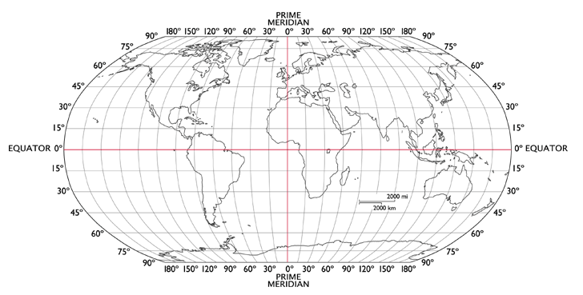
Suicide and Cosmic Factors
So, Durkheim ruled out insanity and alcoholism
Now he turns to “cosmic factors”:
Climate and seasonal temperature
Suicides per million
88.1
55+
172.5
93.3
50-55
43-50
21.1
36-43

Slide 43
Table X – Regional Distribution of Suicide in Italy
 | Suicides per Million Inhabitants |  |  | Ratio of Each Region Expressed in Terms of the North Represented by 100
 | 1866-67 | 1864-76 | 1884-86 | 1866-67 | 1864-76 | 1884-86
North | 34 | 44 | 63 | 100 | 100 | 100
Center | 26 | 41 | 88 | 75 | 93 | 139
South | 8 | 17 | 21 | 24 | 37 | 33
Why did these switch?
The capital of the country switched in 1880.
What’s the implication for climate?

Slide 44
Table XI – Proportional Share of Each Season in the Annual Total of the Suicides of Each Country
When do more suicides occur?
Summer
Why?
Is it heat?
 | Denmark | Belgium | France | Saxony | Bavaria | Austria | Prussia
 | (1858-65) | (1841-49) | (1835-43) | (1847-58) | (1858-65) | (1858-59) | (1869-72)
Summer | 312 | 301 | 306 | 307 | 308 | 315 | 290
Spring | 284 | 275 | 283 | 281 | 282 | 281 | 284
Autumn | 227 | 229 | 210 | 217 | 218 | 219 | 227
Winter | 177 | 195 | 201 | 195 | 192 | 185 | 199
 | 1,000 | 1,000 | 1,000 | 1,000 | 1,000 | 1,000 | 1,000

Slide 45
Table XI – Proportional Share of Each Season in the Annual Total of the Suicides of Each Country
 | France |  | Italy
 | Proportion of 1,000 Annual Suicides in Each Season | Average Temperature of the Seasons | Proportion of 1,000 Annual Suicides in Each Season | Average Temperature of the Seasons
Spring | 281 | 50.36 degrees | 297 | 55.22 degrees
Autumn | 227 | 51.98 degrees | 196 | 55.58 degrees

Slide 46
Table XII – Temperature and Suicide – France (1866-70)
Peak temperature isn’t peak suicide month
 | Average Temperature | No. of Suicides Monthly per 1,000 Annual
January | 36.12 | 68
February | 39.20 | 80
March | 43.52 | 86
April | 50.18 | 102
May | 57.56 | 105
June | 62.96 | 107
July | 66.12 | 100
August | 65.30 | 82
September | 60.26 | 74
October | 52.34 | 70
November | 43.70 | 66
December | 38.66 | 61

Slide 47
Table XII – Temperature and Suicide – Italy (1883-88)
 | Average Temp. Rome | Average Temp. Naples | No. of Suicides Monthly per 1,000 Annual
January | 44.24 | 47.12 | 69
February | 46.76 | 48.74 | 80
March | 50.72 | 51.26 | 81
April | 56.30 | 57.20 | 98
May | 64.40 | 63.61 | 103
June | 71.42 | 70.70 | 105
July | 76.82 | 75.74 | 102
August | 75.74 | 75.56 | 93
September | 70.16 | 71.70 | 75
October | 61.34 | 62.68 | 65
November | 51.62 | 53.96 | 63
December | 46.22 | 49.10 | 61

Slide 48
Table XII – Temperature and Suicide – Prussia (1876-78, 80-82, 85-89)
 | Average Temperature (1848-77) | No. of Suicides Monthly per 1,000 Annual
January | 32.50 | 61
February | 33.31 | 67
March | 37.93 | 78
April | 44.22 | 99
May | 50.84 | 104
June | 57.29 | 105
July | 59.39 | 99
August | 58.48 | 90
September | 52.88 | 83
October | 46.02 | 78
November | 37.27 | 70
December | 33.08 | 61
So, if it’s not heat, what is it?

Slide 49
On Heat…
He does note that sudden extreme changes in temperature increase suicide incidence, but this goes both ways – hot or cold
Did you like the explanation by Morselli for why heat increases suicide?
People have more energy they need to use up because they expend less in trying to stay warm

Slide 50
Table XIII – Comparison of the Monthly Variations of Suicides with the Average Length of Day in France
 | Length of Day |  | Increase and Diminution Increase | No. of Suicides per Month in 1,000 Annual Suicides | Increase and Diminution Increase
 | Hr. | Min.
January | 9 | 19 |  | 68
February | 10 | 56 | From Jan. to | 80 | From Jan. to
March | 12 | 47 | April, 55% | 86 | April, 50%
April | 14 | 29 |  | 102
May | 15 | 48 | From April to | 105 | From April
June | 16 | 3 | June, 10% | 107 | to June, 5%
July | 15 | 4 | From June to | 100 | From June to
August | 13 | 25 | Aug., 17% | 82 | Aug., 24%
September | 11 | 39 | From Aug. to | 74 | From Aug. to
October | 9 | 51 | Oct., 27% | 70 | Oct., 27%
November | 8 | 31 | From Oct. to | 66 | From Oct. to
December | 8 | 11 | Dec., 17% | 61 | Dec., 13%

Slide 51
Table XIV – Number of Suicides at Each Time of Day Among 1,000 Daily Suicides
 | 1871 |  | 1872
Early morning | 35.9 |  | 35.9
Later morning | 158.3 |  | 159.7
Middle of day | 73.1 | 375 | 71.5 | 391.9
Afternoon | 143.6 |  | 160.7
Evening | 53.5 |  | 61.0
Night | 212.6 |  | 219.3
Time unknown | 322 |  | 291.9
Total | 1000 |  | 1000
Majority of suicides occur during the day
Does this bolster his argument that it is day length that explains suicide variation throughout the year?

Slide 52
Hourly suicides
Paris |  | France
 | Hourly Number of Suicides |  | Hourly Number of Suicides
From midnight to 6 | 55 | From midnight to 6 | 30.0
From 6 to 11 | 108 | From 2 to 6 | 61.0
From 11 to noon | 81 | From noon to Z | 32.0
From noon to 4 | 105 | From 6 to noon | 47.0
From 4 to 8 | 81 | From 6 to midnight | 38.0
From 8 to midnight | 61
Why would people prefer during the day?
When social life is most intense?

Slide 53
Table XV – Suicides by day of week
 |  | Proportional Share of Each Sex
 | Share in Per Cent of Each Day in 1,000 Weekly Suicides | Per Cent Men | Per Cent Women
Monday | 15.2 | 69 | 31.0
Tuesday | 15.71 | 68 | 32.0
Wednesday | 14.9 | 68 | 32.0
Thursday | 15.68 | 67 | 33.0
Friday | 13.74 | 67 | 33.0
Saturday | 11.19 | 69 | 31
Sunday | 13.57 | 64 | 36
What’s his explanation here?

Slide 54
Table XVI – Seasonal Variations of Suicide in Several Large Cities Compared with Those of the Whole Country
Proportional Figures for 1,000 Annual Suicides
 | Paris | Berlin | Hamburg | Vienna
 | (1880—92) | (1882— 85-87— 89-90) | (1887—91) | (1871—72)
Winter | 218 | 231 | 239 | 234
Spring | 262 | 287 | 289 | 302
Summer | 277 | 248 | 232 | 211
Autumn | 241 | 232 | 258 | 253
Why are cities different?
Are city jobs less affected by seasonal variations?

Slide 55
Table XVI – Seasonal Variations of Suicide in Several Large Cities Compared with Those of the Whole Country
Proportional Figures for 1,000 Annual Suicides
 | Frankfurt | Geneva | France | Prussia | Austria
 | (1867—75) | (183847) (1852— 54) | (1835—43) | (1869—72) | (1858-59)
Winter | 239 | 232 | 201 | 199 | 185
Spring | 245 | 288 | 283 | 284 | 281
Summer | 278 | 253 | 306 | 290 | 315
Autumn | 238 | 227 | 210 | 227 | 219

Slide 56
Imitation
He spends several pages defining “imitation” again
Ultimately comes up with:
P. 129 “Imitation exists when the immediate antecedent of an act is the representation of a like act, previously performed by someone else; with no explicit or implicit mental operation which bears upon the intrinsic nature of the act reproduced intervening between representation and execution.”
Seems like there is something to this idea:
P. 131 “The corridor has already been mentioned where fifteen invalids hung themselves in succession and also the famous sentry-box at the camp of Boulogne, the scene of several suicides in quick succession.”

Slide 57
Suicides from Sunshine Skyway Bridge as of 2/5/2009
Source: http://www.jumperpool.com/home.htm

Slide 58
Imitation
Durkheim argues that in order for imitation to explain suicide, you need the following:
An origination point must have a greater aptitude for suicide than all surrounding points
An origination point must be something of a cynosure (i.e., provides guidance) for outlying districts
Surrounding regions should be less influenced by the origination point the further they are from it
How sound is his logic?
Do people have to see a suicide directly to imitate it?
And does it matter where they see it? Does the importance of the local paper matter? (p. 139)

Slide 59
Paris
Durkheim concludes from this map that suicides are not based on imitation
Lyon
Bourdeaux
Cannes
Toulouse

Slide 60
Imitation
Conclusion:
P. 140 “In short, certain as the contagion of suicide is from individual to individual, imitation never seems to propagate it so as to affect the social suicide-rate. Imitation may give rise to more or less numerous individual cases, but it does not contribute to the unequal tendency in different societies to self-destruction, or to that of smaller social groups within each society. Its radiating influence is always very restricted; and what is more, intermittent.”
Would not reporting about suicides reduce the incidence of suicides?
Or would it just reduce the particular method of suicide?

Slide 61
Conclusion of Book One
Social suicide rate is not due to:
Insanity
Just psychology
Alcoholism
Seasonal temperature variation
Climate
Imitation
It is, however, influenced by:
Length of day, time of day, and imitation

